Slide 1
What is a dacpac and why should I care?

Slide 2
Why?
Data Tier Application Package
Get your database under source control
Ensure your .sql scripts ”build”
Deploy changes to the database schema with changes to your app
No more migration scripts – simply describe your desired state
Cross platform build and deployment support

Slide 3
Process
Create .sql scripts
Build
.dacpac
Deploy
Create .sqlproj

Slide 4
Process
Tooling
Authoring
Building
Deploying

Slide 5
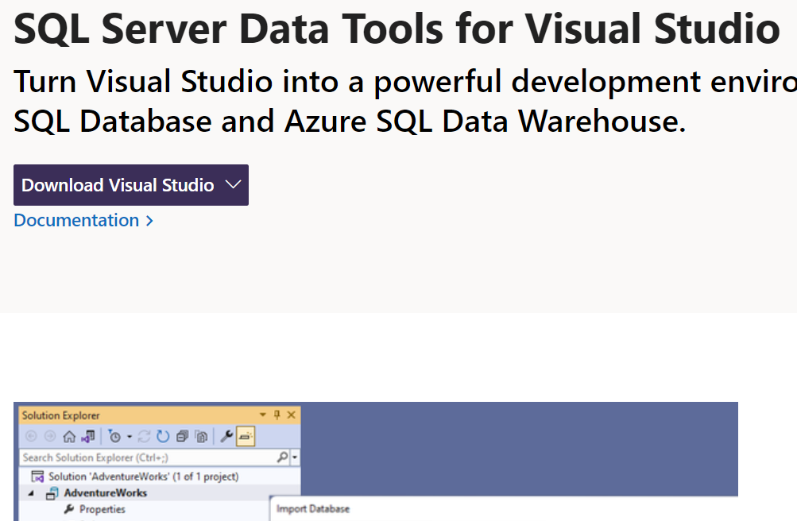
Tooling

Slide 6
Process
Create .sql scripts
Build
.dacpac
Deploy
Create .sqlproj

Slide 7
Tooling
Visual Studio database project (.sqlproj)
Demo

Slide 8
Process
Create .sql scripts
Build
.dacpac
Deploy
Create .sqlproj

Slide 9
Authoring
Visual Studio .sqlproj
Demo (import, table designer, instellisense, build)

Slide 10
Process
Create .sql scripts
Build
.dacpac
Deploy
Create .sqlproj

Slide 11
Building
Visual Studio build (Windows only)
MsBuild.Sdk.SqlProj community project
dotnet new / dotnet build (in preview)
Demo

Slide 12

Process
Create .sql scripts
Build
.dacpac
Deploy
Create .sqlproj

Slide 13
Process
Create .sql scripts
Build
.dacpac
Deploy
Create .sqlproj

Slide 14
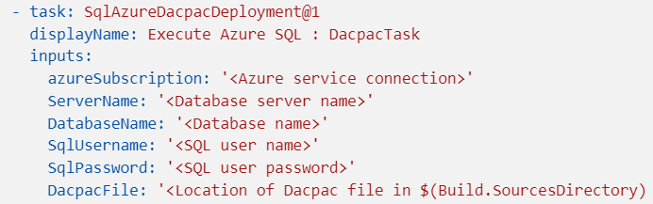
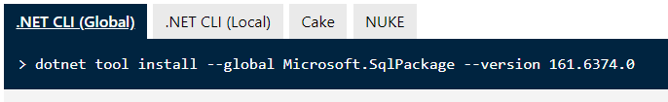
Deployment

Slide 15
Deployment
sqlpackage CLI
dotnet tool install microsoft.sqlpackage –g
sqlPackage /Action:Publish /SourceFile:”DacpacDemo.dacpac" /TargetConnectionString:"Server=(localdb)\mssqllocaldb;Initial Catalog=DacpacDemo;Integrated Security=true;Encrypt=False"
dotnet publish (using MsBuild.SDK.SqlProj)
For local development
Azure DevOps Task (also a similar one on GitHub)
Demo

Slide 16

Why .dacpac?
Ensure high quality and consistent SQL schema
Desired state configuration
Publish magic!

